Slide 1
Design of Efficient 4x4 Enhanced Pipeline multiplier Based with Various Optimization Techniques
Maisam Alaa 1200650@student.birzeit.edu Adam Shareef Nassan 1202076@student.birzeit.edu

Slide 2
Abstract
This project presents the design and implementation of a highly efficient 4x4 pipelined multiplier using CMOS (Complementary Metal-Oxide-Semiconductor) devices. The primary objective of this work is to create a multiplier that excels in both speed and power efficiency by making innovative use of CMOS technology. The multiplier architecture employs a combination of parallelism, pipelining, and advanced CMOS design techniques to achieve high-speed multiplication operations with reduced power consumption. The key contributions of this work include a detailed exploration of power-efficient CMOS logic design, clock gating strategies, and the optimization of pipeline stages.

Slide 3
Results
In the 4x4 pipelined multiplier, the operation is controlled by a clock signal that drives the pipeline stages. Each stage is synchronized to the clock signal, ensuring precise timing and data flow throughout the multiplier. This mechanism allows for efficient and parallelized computation of multiplication operations while maintaining data integrity and accuracy.

Slide 4
In comparing literature on 4x4 bit pipelined multipliers:
Different design techniques and optimization strategies may be explored.
Performance metrics, including speed, area, and power consumption, may vary.
The number of pipeline stages and technology choices can differ.
Some papers may provide comparisons with other multiplier architectures.
Validation methods range from simulation to hardware implementation.
Trade-offs and limitations may be discussed.
Application-specific optimizations could be considered.
Consider publication dates and citation counts for relevance and currency.

Slide 5
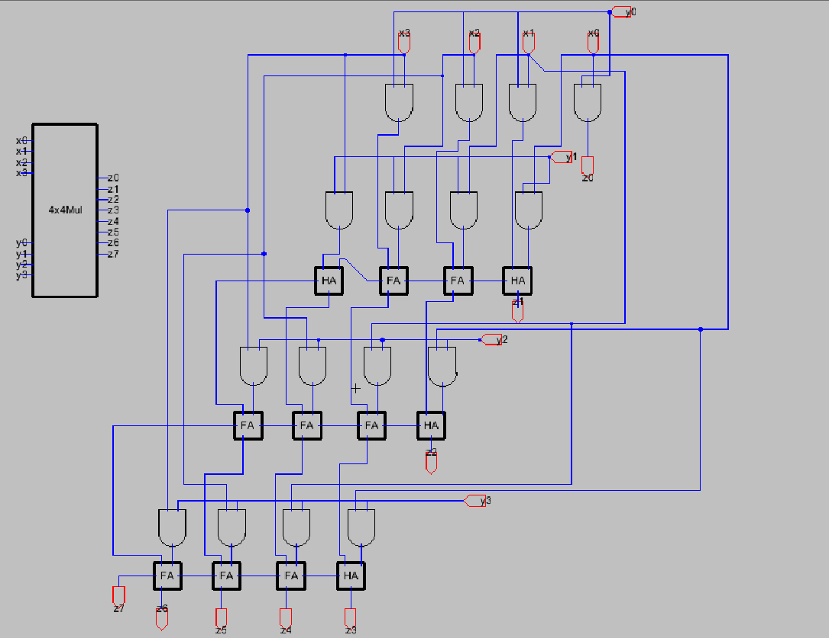
Design without pipelining

Slide 6
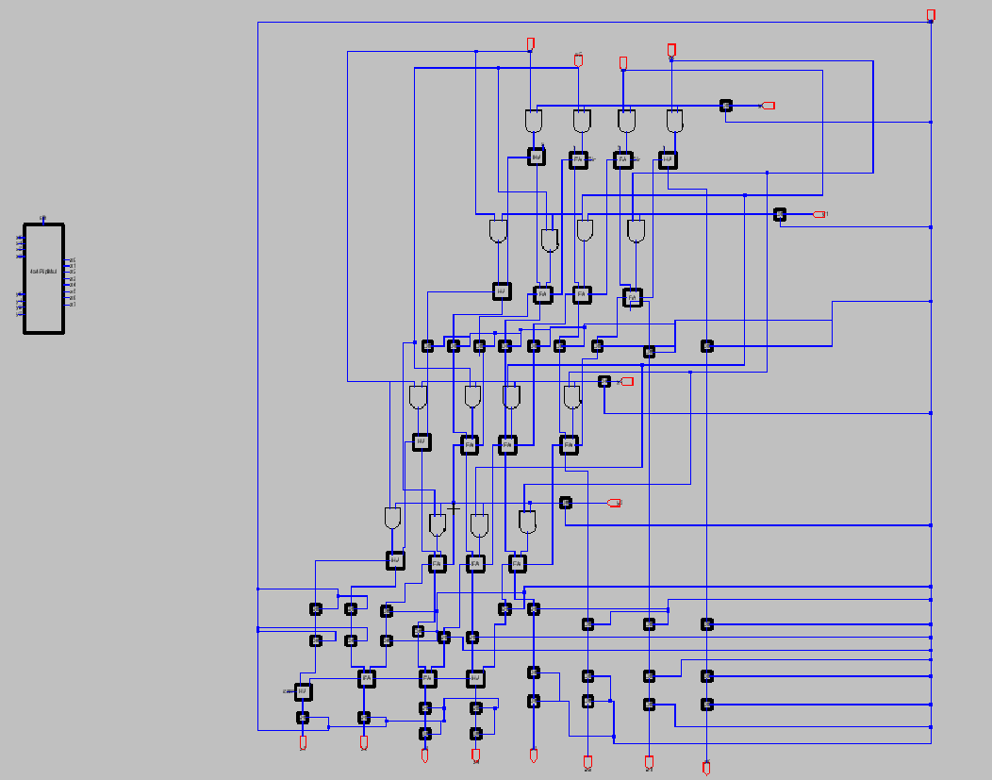
Final schematic design with pipelining

Slide 7
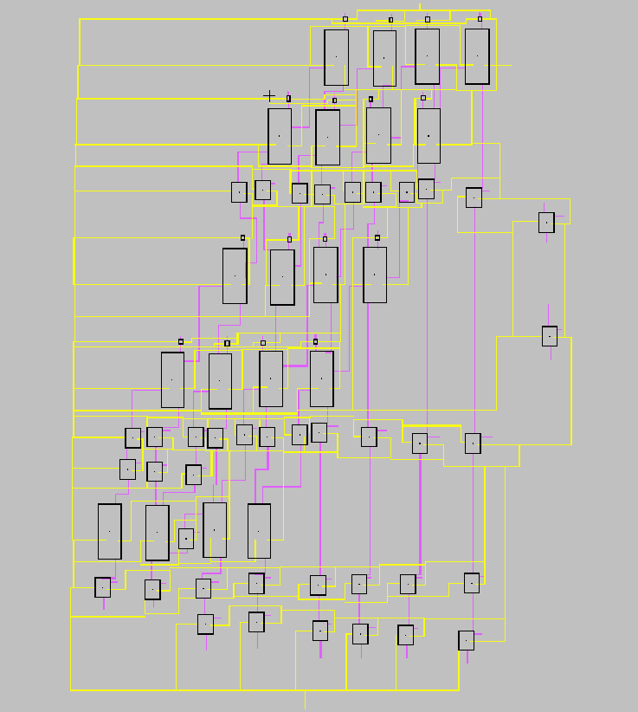
Final layout design with pipelining

Slide 8
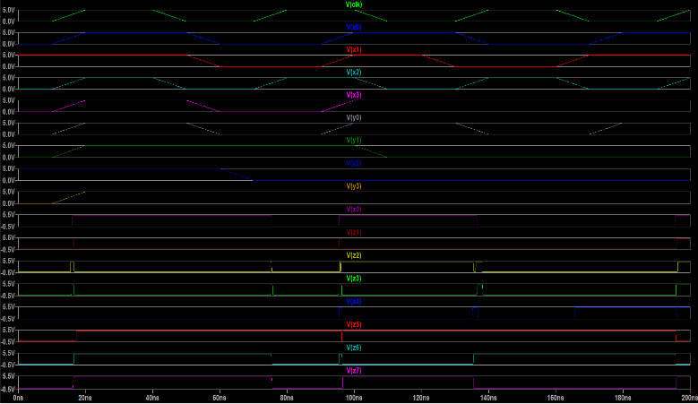
Simulation results of the final design

Slide 9
Conclusion
In conclusion, the design and implementation of a 4x4 bit pipelined multiplier using CMOS technology, along with the integration of half adders and full adders, represent a significant achievement in the realm of microelectronics and digital circuitry. The use of CMOS technology ensures low power consumption and compact design, making it well-suited for modern electronic devices. By breaking down the multiplication process into stages and processing multiple bits simultaneously, this approach offers substantial advantages in terms of reduced latency and improved throughput. This project has not only demonstrated the practical application of integrated circuit technology but also highlighted its critical role in modern computing systems.

Slide 10
AREA, POWER, AND DELAY OPTIMIZATION
To address this, we've devised an innovative approach that dramatically reduces the gate count, simplifies the layout, and minimizes the need for additional components. Our optimized design achieves this by judiciously employing just two 2-input AND gates, one 2-input OR gate, and a pair of inverters. This clever reconfiguration preserves the essential functionality and performance characteristics of the XOR gate while significantly reducing both the silicon area occupied and the associated manufacturing costs.

Slide 11
Our latest iteration of the 2-Input XOR gate showcases our ingenuity, employing just four PMOS and four NMOS transistors, a significant reduction in transistor count that enhances resource efficiency. This streamlined design maintains essential functionality and high performance while reducing physical footprint and production expenses. Our commitment to excellence and responsible resource management shines through in this remarkably efficient XOR gate, exemplifying our dedication to technological innovation.

Slide 12
 | Power | Delay
4x4 Multiplier | 280Uw | 22.4ps
4x4 Pipelined Multiplier | 179.375uW | 14.35ps
Transistor (L=2,W=10) | 1.62uW | 0.072ps

